Slide 1

FACULTY OF NATURAL AND APPLIED SCIENCES
Department of Biology, Microbiology and Biotechnology
Assessment of Microflora of Indoor Air in Reception Areas of Some Academic Buildings at Nile University of Nigeria, Abuja
PRESENTED BY
Aisha Salisu Isansi
Matric Number: 20222899

Slide 2
1.0 Introduction
Background to the Study
Indoor air quality (IAQ) has emerged as a critical global public health concern, especially as urban populations spend up to 90% of their lives in enclosed environments (WHO, 2009).
Biological Bioaerosols: Airborne fungi are ubiquitous biological pollutants capable of growing on materials under high relative humidity.
Resilience and Dissemination: Fungi replicate via microscopic spores which are aerosolized by ventilation systems and occupant activities.
Tropical Climate Context: Tropical environments in Abuja experience warm, dry conditions during the dry season that influence airborne fungal loads and spore dissemination patterns.

Slide 3
1.0 Introduction (cont.)
Statement of the Research Problem
Lack of Routine Air Quality Monitoring: Despite high occupant density in academic buildings, there is a total lack of systematic air monitoring systems in West African educational spaces.
Elevated Microbial Exposure Risks: High human occupancy combined with natural/mechanical ventilation limitations can lead to fungal concentrations exceeding standard limits, resulting in Sick Building Syndrome (SBS).
Emerging Global Antifungal Resistance: Widespread agricultural and clinical overuse of antimicrobials has triggered environmental selection pressure, raising the threat of multi-drug resistant environmental mould strains.
Paucity of Local Data: There is a lack of published baseline research regarding culturable fungal concentrations (CFU/m3) and their susceptibility profile in the Abuja Federal Capital Territory.

Slide 4
1.0 Introduction (cont.)
Justification of the Study
Conducting this research at Nile University of Nigeria is highly timely and necessary for the following crucial reasons:
Occupant Health Safety
Antifungal Resistance Mapping
Facility Remediation Guidelines
University reception areas serve as primary transit hubs where students, staff, and visitors gather. Controlling bioaerosols directly prevents chronic respiratory illnesses.
Establishing susceptibility maps of airborne opportunistic moulds (like Aspergillus and Penicillium) aids clinical prophylaxis in the event of local outbreaks.
Understanding concentrations during the dry season empowers administrators to optimize HVAC filters, cleaning cycles, and architectural air-exchanges.

Slide 5
Aims and Objectives
Overall Aim: To isolate, identify, and determine the in vitro antifungal susceptibility profiles of indoor airborne fungi recovered from selected academic reception environments at Nile University of Nigeria, Abuja, during the dry season.
Specific Objectives:
1
Isolation and Morphological Identification: Isolate airborne fungi and identify them down to species level using macro-morphological and micro-morphological indicators.
2
Density and Distribution Mapping: Determine colony counts and map estimated fungal concentrations (CFU/m3) across selected university halls for morning and afternoon periods.
3
Susceptibility Screening: Analyze in vitro susceptibility of isolates against commonly used antimycotics (Ketoconazole, Fluconazole, and Griseofulvin) using the agar well diffusion technique.

Slide 6
Significance of the Study
This study establishes baseline mycological safety data, directly benefiting three distinct stakeholders:
University Administrators and Facilities Managers
Provides empirical grounds to justify HVAC filter retrofits, dampness remediation, and disinfection schedules in reception areas.
Public Health and Medical Professionals
Contributes critical resistance tracking metrics showing intrinsic resistance patterns (such as total fluconazole resistance) in environmental moulds.
The Academic Research Community
Expands the clinical mycology literature regarding tropical aerobiology in West African higher education ecosystems.

Slide 7
Materials and Methods
Study Area and Experimental Design
Location: Nile University of Nigeria, Abuja FCT. High-density campus buildings serving academic and administrative hubs.
Sample Sites: Common reception areas of three core structures: Niger Hall, Volta Hall, and Limpopo Hall.
Temporal Analysis: Cross-sectional study analyzing variations between early morning (8:00-10:00 AM) and afternoon (2:00-4:00 PM) intervals.
Climatic Variable: Conducted in dry season, characterized by dry dust-laden Harmattan trade wind.
Sampling Scheme: 3 buildings x 2 periods (AM/PM) x duplicate sampling plates exposed for 15 minutes each at key transit center points.
Statistic: Descriptive statistics including frequency distributions, relative abundances, and diversity indices (Shannon-Wiener, Pielou’s Evenness, Simpson’s).
Niger Hall: Occupancy and colony movement – afternoon counts increased 33% from AM to PM, reflecting late-occupancy activity patterns.

Slide 8
Materials and Methods (cont.)
Sample Collection and Mathematical Conversion
Active Media: SDA supplemented with chloramphenicol (50 µg/mL) to inhibit bacterial growth.
Exposure Method: Average settling time.
Volumetric Concentration: Calculated using Omeliansky's Formula (1923).
Omeliansky's Formula:
CFU/m³ = (n × 10⁴) / (π × r² × t)
where n = colonies, r = Petri plate radius (cm), t = exposure time (15 min), correction factor is 10⁴–10⁵
Taxonomic Identification and Susceptibility Protocols
Incubation: 25-28 °C for 5-7 days. Subcultured to ensure purity.
Microscopic Characterization: LPCB wet mounts under x40 and x100.
Susceptibility Testing: Agar well diffusion. Ketoconazole (50 µg/mL), Fluconazole (25 µg/mL), Griseofulvin (100 µg/mL).

Slide 9
Results: Volumetric Bioaerosol Concentrations
A total of 46 fungal colonies were recovered from 12 plates. All sampling sites recorded concentrations within the WHO safe boundary of 50 CFU/m3.
Morning Spikes: Volta Hall AM (47.2 CFU/m3) and Limpopo Hall AM (47.2 CFU/m3) approached the WHO limit but remained within safe boundaries.
Afternoon Reductions: Volta decreased to 31.4 CFU/m3 (45% drop) and Limpopo to 41.9 CFU/m3, likely due to continuous air conditioning filtration.
Niger Hall Exception: Increased from 31.4 (AM) to 41.9 CFU/m3 (PM) (33% increase), corresponding to increased afternoon occupancy.

Slide 10
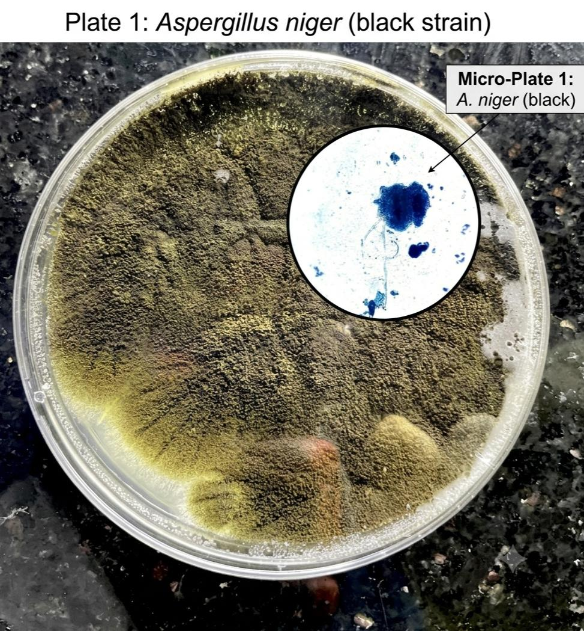
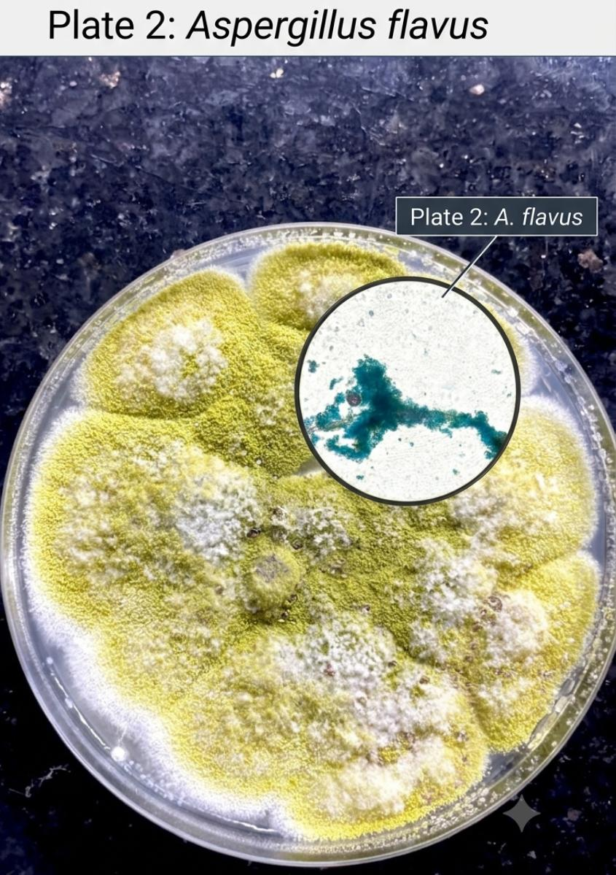
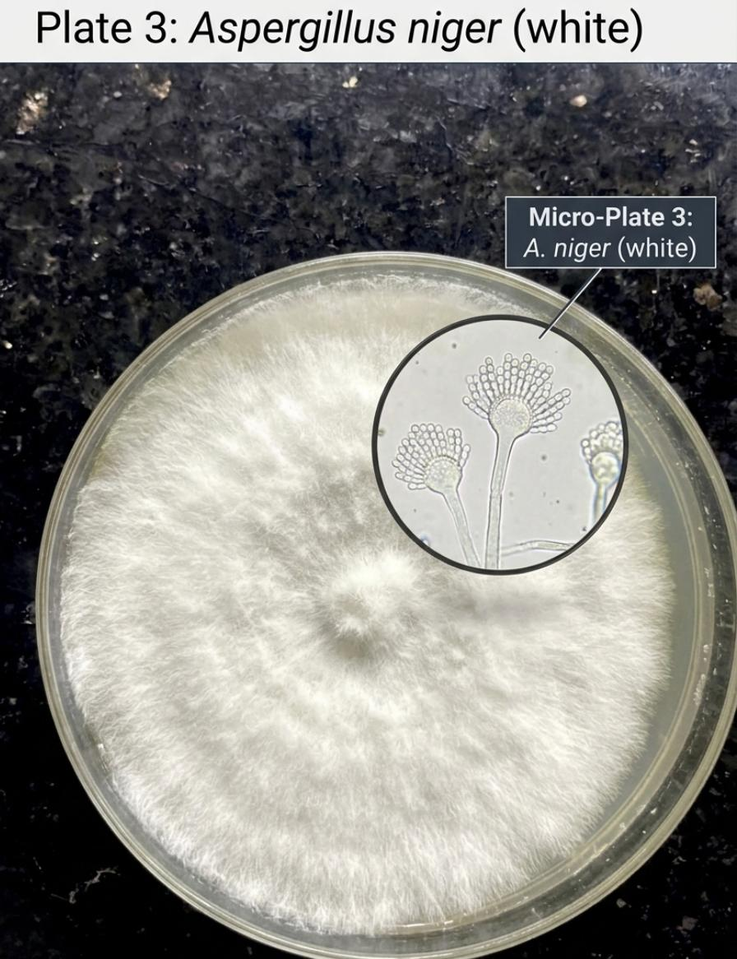
Results: ​Macroscopic and Microscopic Identification of Isolates
Aspergillus niger (black strain) showing black, powdery colonies and microscopic large globose vesicles with dark conidia.
Aspergillus flavus featuring yellow-green, granular colonies with radiate conidial heads and rough-walled conidiophores
Aspergillus niger (white strain) displaying white, cottony colonies with globose vesicles and hyaline conidia.

Slide 11
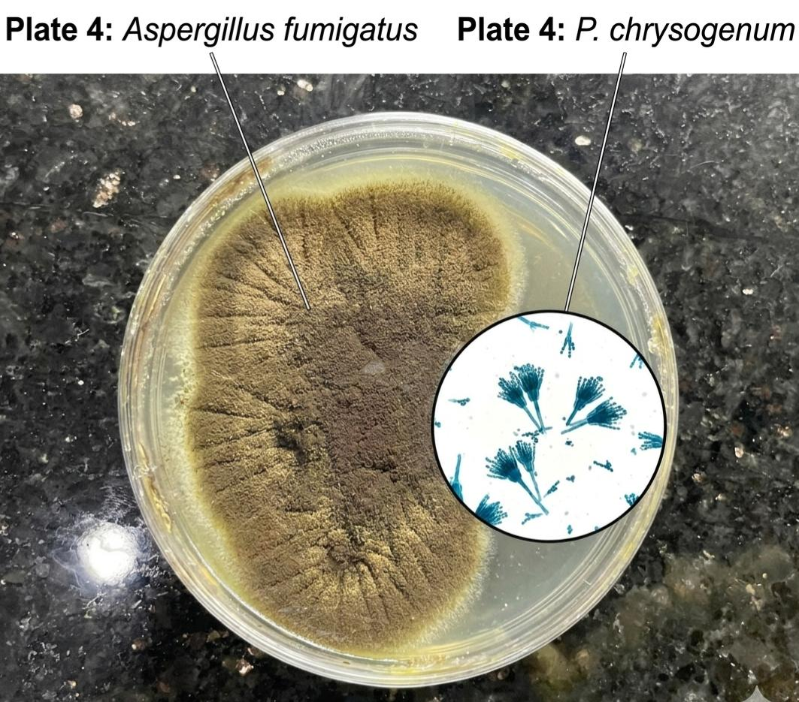
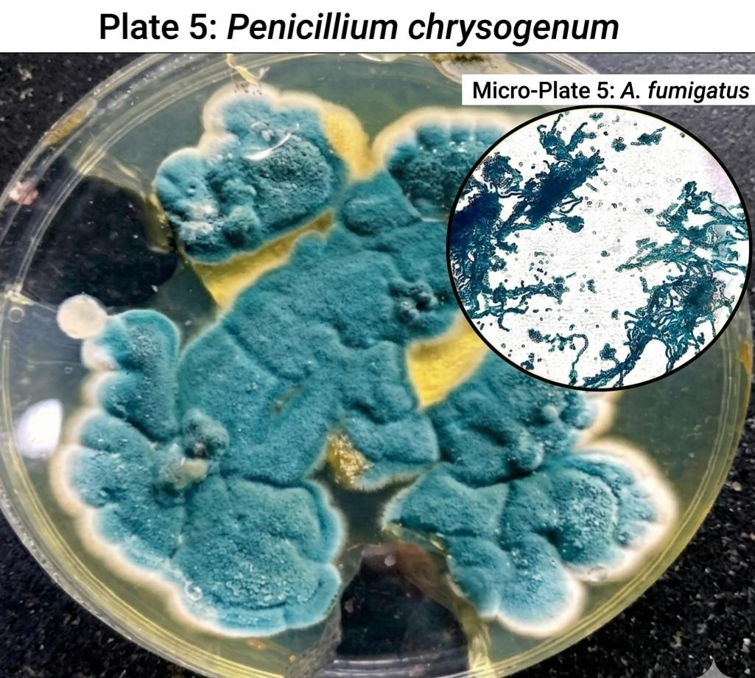
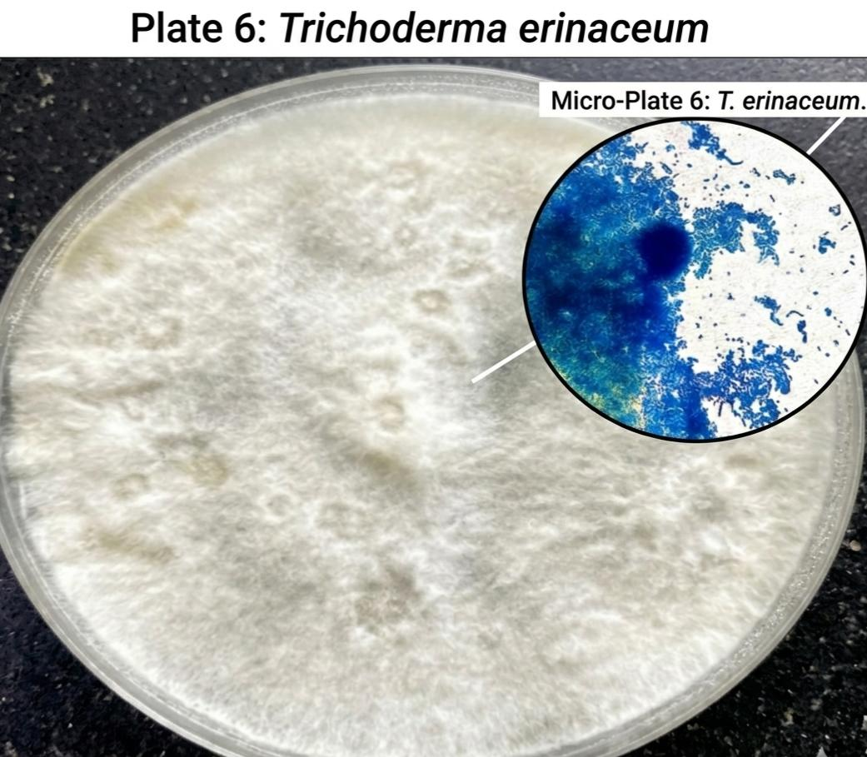
Results: Species ​Macroscopic and Microscopic Identification of Isolates
Aspergillus fumigatus showing smokey blue-green, velvety colonies with columnar conidial heads.
Penicillium chrysogenum highlighting blue-green colonies with yellow exudate and distinct brush-like penicilli.
Trichoderma erinaceum showing white, cottony colonies with rapidly branching conidiophores and green conidia clusters.

Slide 12
Results
Species Composition and Diversity Indices
Species Composition: Six fungal species identified: Aspergillus niger (black strain, 26.1%), Aspergillus flavus (21.7%), Aspergillus niger (white strain, 17.4%), Penicillium chrysogenum (15.2%), Aspergillus fumigatus (10.9%), and Trichoderma erinaceum (8.7%).
Shannon-Wiener Index (H′): High diversity across all buildings: Niger Hall (1.773), Volta Hall (1.714), and Limpopo Hall (1.646), reflecting a diverse indoor mycobiota.
Pielou’s Evenness (J): Values ranged from 0.919 (Limpopo Hall) to 0.989 (Niger Hall), indicating equitable species distribution with no single pathogen dominating.
Simpson’s Diversity (1–D): Ranged from 0.789 (Limpopo Hall) to 0.827 (Niger Hall), further confirming high species diversity across all sampled buildings.
Dominant Species: Aspergillus niger (black strain) was consistently the most frequently isolated species across all three buildings, with highest prevalence in Limpopo Hall (5 isolates).

Slide 13
Results (cont.)
Antifungal Susceptibility Profiling
Ketoconazole (50 µg/mL): Most effective agent with mean inhibition zones of 13–22 mm. A. niger (black) and A. fumigatus were the most susceptible (22 mm and 21 mm respectively).
Fluconazole (25 µg/mL): No inhibitory activity observed (0 mm zones) against all tested species, confirming 100% intrinsic resistance across all isolates.
Griseofulvin (100 µg/mL): Least active agent with mean zones of 8–17 mm. A. fumigatus showed the highest susceptibility (17 mm); T. erinaceum showed the least (8 mm).
Trichoderma erinaceum: Showed the greatest resistance among all tested species, with resistant category responses to all three antifungal agents including ketoconazole (13 mm).
Clinical Implication: Ketoconazole is the most effective therapeutic option for environmental mould infections in this region; fluconazole resistance warrants clinical awareness.

Slide 14
Discussion and Key Recommendations
Interpretation of Findings and Actionable Steps
Indoor Air Quality: All three buildings complied with WHO guideline of 50 CFU/m³. HVAC filtration effectively reduced afternoon concentrations in Volta and Limpopo Halls. Niger Hall showed a 33% PM increase linked to occupancy.
Fungal Diversity: High Shannon-Wiener indices (1.646–1.773) and evenness values (0.919–0.989) indicate balanced mycobiota. The predominance of Aspergillus species is consistent with tropical educational settings.
Antifungal Resistance: Total fluconazole resistance across all isolates is clinically significant. Environmental selection pressure from agricultural and clinical antifungal overuse may be contributing to emerging resistance.
Recommendation 1: Implement routine indoor air quality monitoring programmes in all academic buildings, particularly during morning peak hours.
Recommendation 2: Conduct further research with seasonal comparisons (dry vs. wet season) and molecular identification methods for comprehensive aeromycota profiling.
Recommendation 3: Launch clinical awareness campaigns regarding fluconazole resistance in environmental moulds to guide empirical therapy in the FCT region.

Slide 15
Conclusion
All three academic reception halls recorded indoor fungal concentrations within the WHO safe boundary of 50 CFU/m3, though morning values at Volta Hall and Limpopo Hall approached this threshold, indicating potential risk during peak occupancy.
Six fungal species were identified, with Aspergillus niger consistently recovered across all buildings, highlighting its prevalence in indoor academic environments in tropical settings.
All isolates demonstrated 100% resistance to Fluconazole, while showing high susceptibility to Ketoconazole, suggesting Ketoconazole as the most effective therapeutic option for environmental mould infections in this region.
High evenness indices suggest a balanced mycobiota with no single pathogen dominating, but the consistent presence of opportunistic moulds warrants ongoing surveillance.

Slide 16
Recommendations
Implementation of routine indoor air quality monitoring programmes in all academic buildings, particularly during morning hours when fungal concentrations peak.
Further research incorporating seasonal comparisons (dry vs. wet season) and molecular identification methods to provide a more comprehensive understanding of indoor aeromycota.
Clinical awareness campaigns regarding the total Fluconazole resistance observed in environmental mould isolates, to guide empirical therapy decisions in the FCT region.

Slide 17
References
Arendrup, M. C., Meletiadis, J., Mouton, J. W., Lagrou, K., Hamal, P. and Guinea, J. (2022). Method for the determination of broth dilution minimum inhibitory concentrations of antifungal agents for conidia forming moulds. EUCAST Definitive Document E.DEF 9.3.2.
World Health Organization (WHO). (2009). WHO Guidelines for Indoor Air Quality: Dampness and Mould. WHO Regional Office for Europe, Copenhagen.
Omeliansky, V. L. (1923). A method for the bacteriological examination of air. Journal of Hygiene, 22(1), 1-12.
Shannon, C. E. and Weaver, W. (1949). The Mathematical Theory of Communication. University of Illinois Press, Urbana.
Simpson, E. H. (1949). Measurement of diversity. Nature, 163(4148), 688.

Slide 18
THANK YOU
FOR LISTENING

